Slide 1
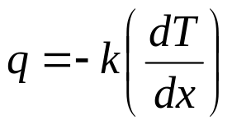
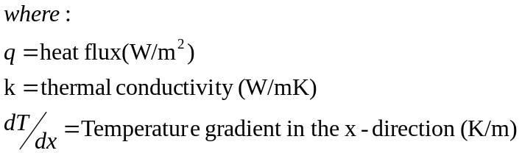
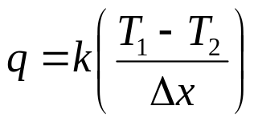
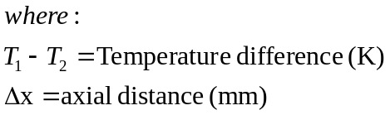
Conduction
Fourier’s Equation for 1-D
k₁
k₂
T₁
T₂
T₃
  The -ve sign results from the convention of defining a positive heat flow in the direction of a negative temperature gradient
Δx₁₂
Δx₂₃
  Assuming constant conductivity and changing the sign convention, this can be integrated to give:

Slide 2
Conduction (cont)
1D steady-state
hand calculation
Calculate T₂
Note that q₁₂=q₂₃ =q₁₃
Key equation is:
k₁=10W/mK
k₂=5W/mK
T₁ =700K
T₂
T₃ =300K
q₁₂
q₂₃
Δx₁₂ =10mm
Δx₂₃ =20mm

Slide 3
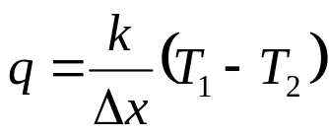
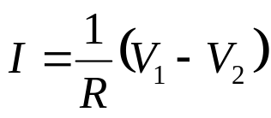
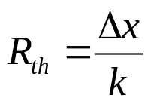
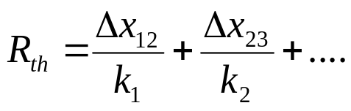
Conduction (cont)
Method 2 – Electrical Analogy
Compare the following:
A thermal resistance can be defined as
Thus for multiple walls, these resistances to heat transfer can be added in series:
Thermal Electrical

Slide 5
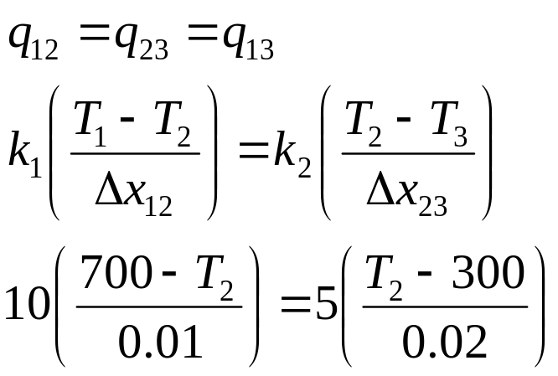
Conduction (cont)
Method 1
Note that q₁₂=q₂₃=q₁₃
k₁=10W/mK
k₂=5W/mK
T₁ =700K
T₂
T₃ =300K
q₁₂
q₂₃
Δx₁₂ =10mm
Δx₂₃ =20mm
Solving this gives:
  T2=620K

Slide 6
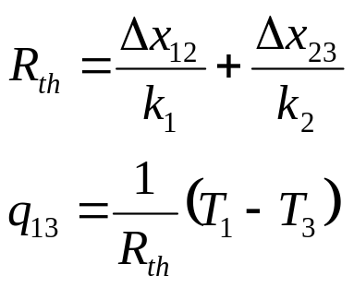
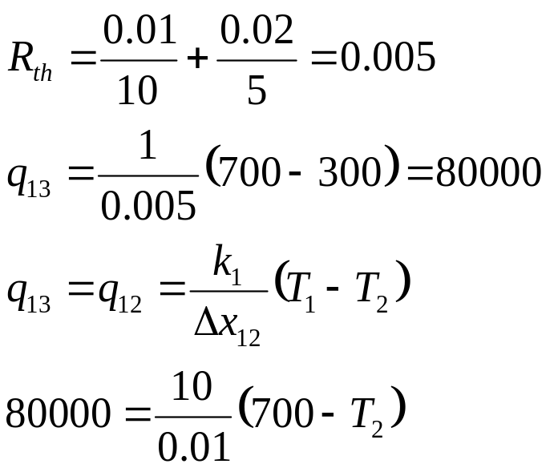
Conduction (cont)
Method 2 – Electrical Analogy (cont)
Thus
k₁=10W/mK
k₂=5W/mK
T₁ =700K
T₂
T₃ =300K
q₁₂ =q₂₃ =q₁₃
q₁₂
q₂₃
Δx₁₂ =10mm
Δx₂₃ =20mm
Solving this gives:
  T2=620K

Slide 7
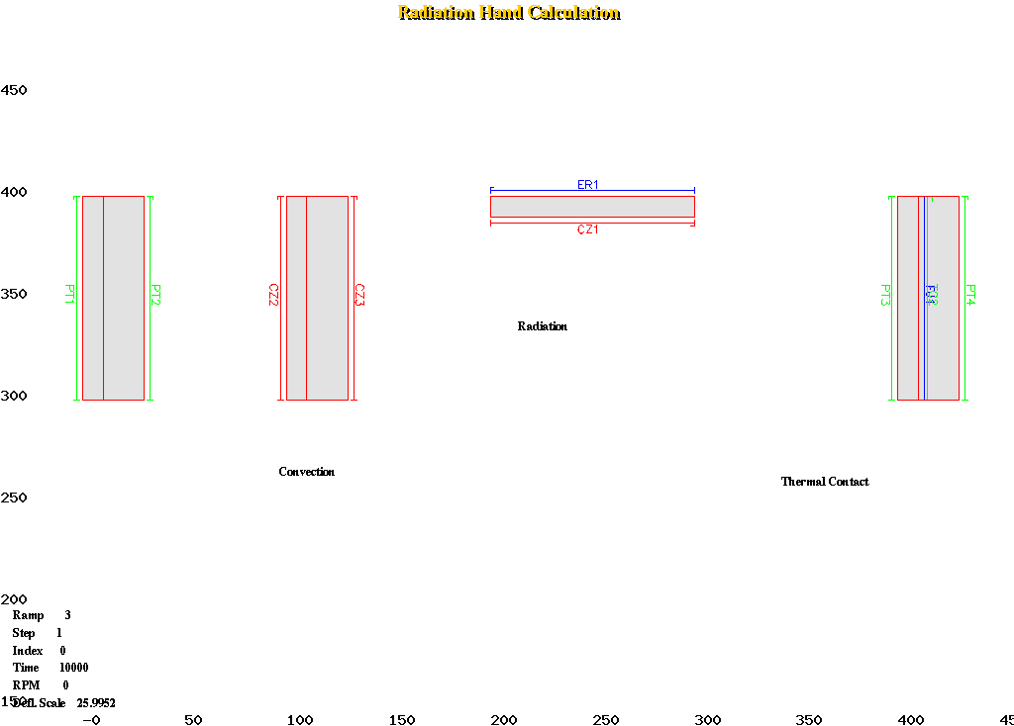
Model Details - Conduction
Open SC03 with hand_calc_base.pm
Locate the geometry for the conduction example
Apply Prescribed temperatures using Thermal/Prescribed Temps
Run the model (Analysis/Run)
Use Results/Get Values to determine the temperature at the T₂
Extension Activity
  Increase the width of the blocks
    double just the left block width
    double just the right block width
    double both block widths
T₂
PRESCRIBED TEMPERATURES
-----------------------
| INDEX | 1
| TEMPERATURE | t30
| INDEX | 2
| TEMPERATURE | t26

Slide 8
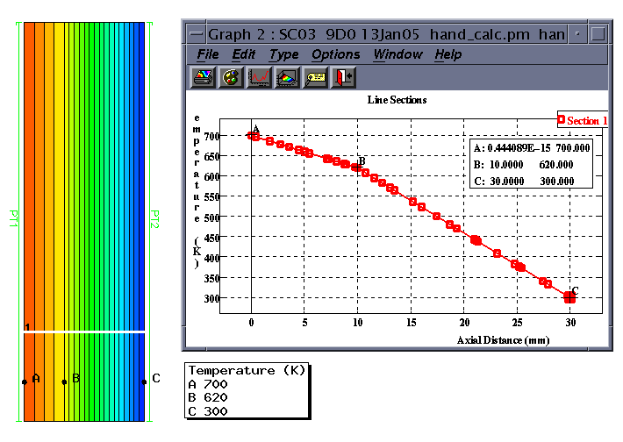
Conduction (cont)
SC03 modelling of the simple case
  hand_calc.pm

Slide 9

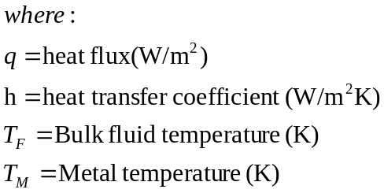
Convection
Newton’s Equation for 1-D
k₂
k₃
T₂
T₃
T₄
T_{F5}
h₅
T_{F1}
h₁
Δx₂₃
Δx₃₄

Slide 10
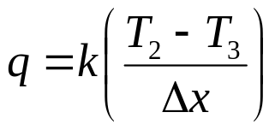
Convection (cont)
1D steady-state hand calculation
  combined conduction & convection
Calculate T₂ ,T₃ & T₄
Note that
q₁₂=q₂₃ =q₃₄ =q₄₅ =q₁₅
Key equations
are:
k₂=10W/mK
k₃=5W/mK
T₂
T₃
T_{F5}=300K
h₅ =100W/m²K
T_{F1}=700K
h₁ =200W/m²K
T₄
q₁₂
q₂₃
q₃₄
q₄₅
Δx₂₃ =10mm
Δx₃₄ =20mm

Slide 11

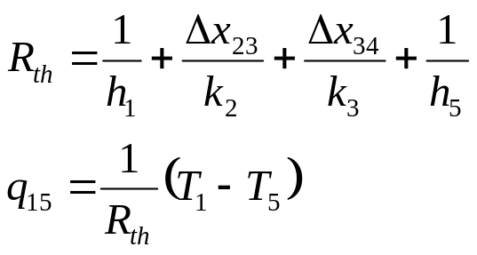
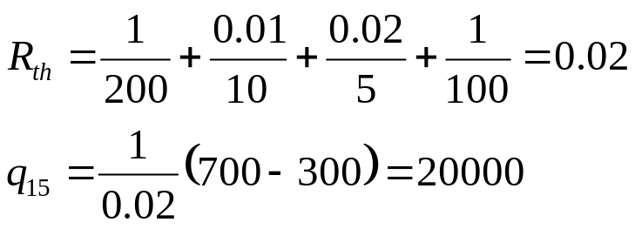
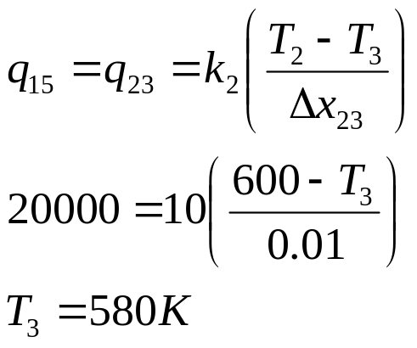
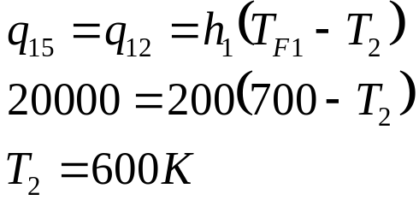
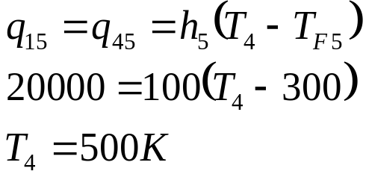
Convection (cont)
k₂=10W/mK
k₃=5W/mK
T₂
T₃
T_{F5}=300K
h₅ =100W/m²K
T_{F1}=700K
h₁ =200W/m²K
T₄
q₁₂
q₂₃
q₃₄
q₄₅
Δx₂₃ =10mm
Δx₃₄ =20mm
Thus

Slide 13
Model Details - Convection
Open SC03 with hand_calc_base.pm
Locate the geometry for the convection example
Apply Convecting Zones using Thermal/Convecting Zones
Run the model (Analysis/Run)
Use Results/Get Values to determine the temperature at T₂, T₃ and T₄
Extension Activity
  Increase the temperature of convecting zone 2
    by 100K
    by 200K
    by 300K
  See the effects on T₃
T₂
T₃
T₄
CONVECTING ZONES
----------------
| INDEX | 2
| FLUID TYPE | air
| TEMPERATURE | t30
| PRESSURE | 0
| HTC | 0.2
| INDEX | 3
| FLUID TYPE | air
| TEMPERATURE | t26
| PRESSURE | 0
| HTC | 0.1

Slide 14
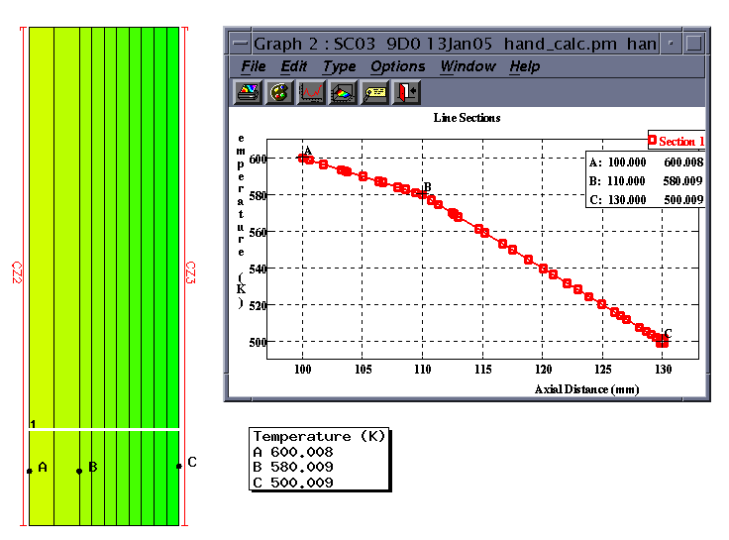
Convection (cont)
SC03 modelling of the simple case
  hand_calc.pm

Slide 15

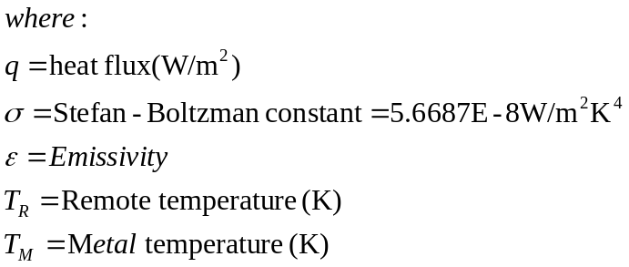
Radiation
Stefan-Boltzman Equation:
T_{R}
T_{M}
ε

Slide 16
Radiation (cont)
1D steady-state
hand calculation
Calculate T₂ & T₃
Note that q₁₂=q₂₃=q₃₄
T₁ =700K
T₂
ε=0.5
Δx=10mm
k=5W/m²K
T₃
T₄=300K, h=200W/m²K

Slide 17
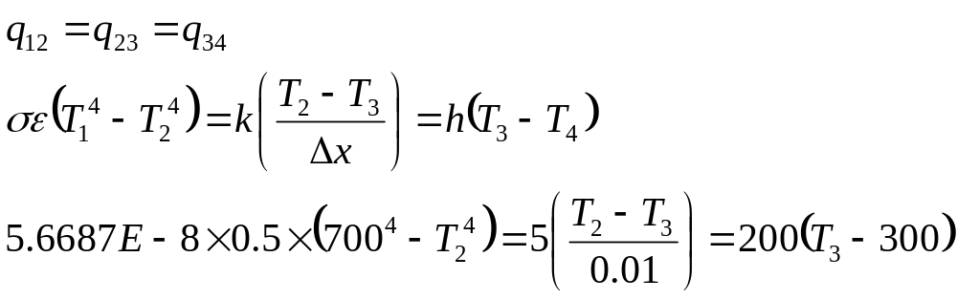
Radiation (cont)
Note that q₁₂=q₂₃=q₃₄
T₁ =700K
T₂
ε=0.5
Δx=10mm
k=5W/m²K
T₃
T₄=300K, h=200W/m²K
Solving this gives:
  T2=344.836K, T3=332.027K

Slide 19
Model Details - Radiation
Open SC03 with hand_calc_base.pm
Locate the geometry for the radiation example
Apply Convecting Zone using Thermal/Convecting Zones
Apply External Radiation using Thermal/External Radiation
Run the model (Analysis/Run)
Use Results/Get Values to determine the temperature at T₂ and T₃
Extension Acivity
  Change the emissivity in the range 0 to 1
  See the effect on T₂ and T₃
T₂
T₃
CONVECTING ZONES
----------------
| INDEX | 1
| FLUID TYPE | air
| TEMPERATURE | t26
| PRESSURE | 0
| HTC | 0.2
EXTERNAL RADIATION
------------------
| INDEX | 1
| EMISSIVITY | 0.5
| REMOTE TEMP. | t30

Slide 20
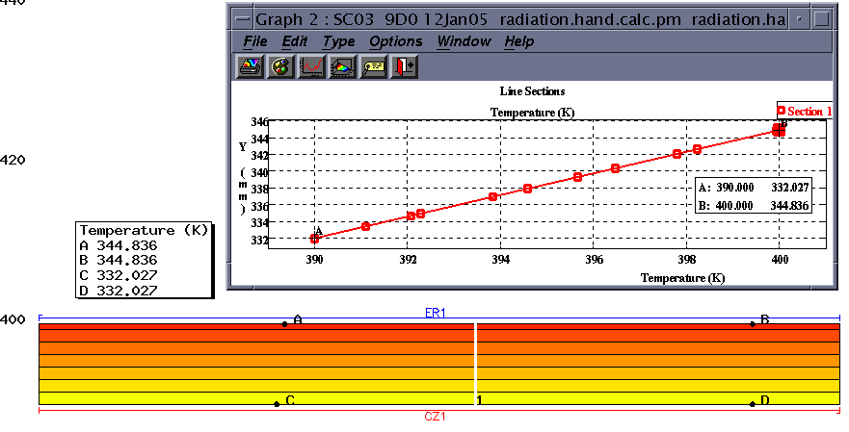
Radiation (cont)
SC03 modelling of the simple case
  hand_calc.pm

Slide 21
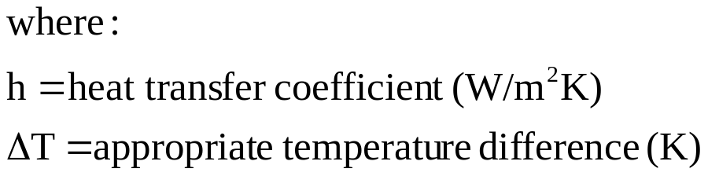
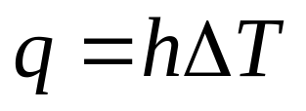
Radiation-in SC03 (cont)
Stefan-Boltzman Equation:
T_{R}
T_{M}
In SC03 this is solved by re-arranging the equation into the same form as the convection equation, i.e.

Slide 22
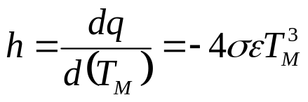
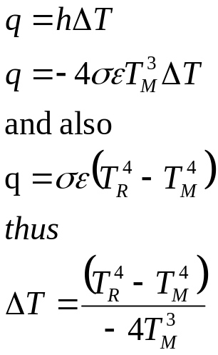
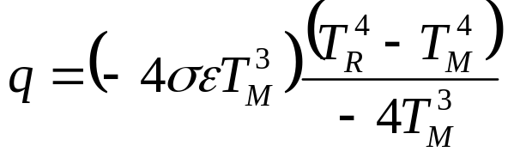
Radiation-in SC03 (cont)
Manipulation of the equation:
  define htc as dq/d(T_{M})
  compare against standard convection equation
  thus, rearranged in ‘convection’ form, the radiation equation is:

Slide 23
Radiation-in SC03 (cont)
1D steady-state
hand calculation
Calculate T₂ & T₃
Note that q₁₂=q₂₃=q₃₄
T₁ =700K
T₂
ε=0.5
Δx=10mm
k=5W/m²K
T₃
T₄=300K, h=200W/m²K

Slide 24
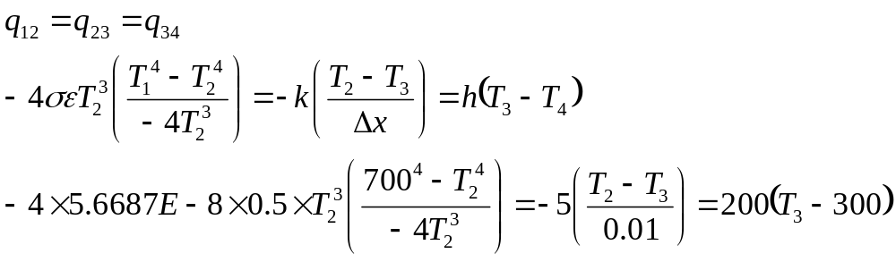
Radiation-in SC03 (cont)
Note that q₁₂=q₂₃=q₃₄
T₁ =700K
T₂
ε=0.5
Δx=10mm
k=5W/m²K
T₃
T₄=300K, h=200W/m²K
Solving this gives:
  T2=344.836K, T3=332.027K

Slide 25

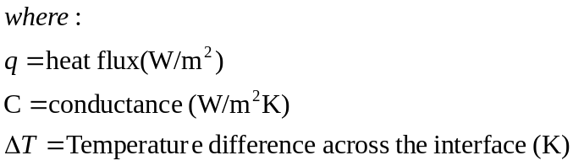
Thermal Contact
Additional thermal resistance at an interface
k₁
k₃
C
T₁
T₂
T₃
T₄
  Note that this is the same form as the convection equation:
Δx₁₂
Δx₃₄
  Thus in the same way that 1/h is a measure of the thermal resistance, 1/C is the equivalent for contact resistance

Slide 26
Thermal Contact (cont)
1D steady-state
hand calculation
Calculate T₂ & T₂
Note that q₁₂=q₂₃ =q₃₄ =q₁₄
Key equations are:
k₁=10W/mK
k₃=5W/mK
C=500W/m²K
T₁ =700K
T₂
T₃
T₄ =300K
q₁₂
q₃₄
q₂₃
Δx₁₂ =10mm
Δx₃₄ =20mm

Slide 27
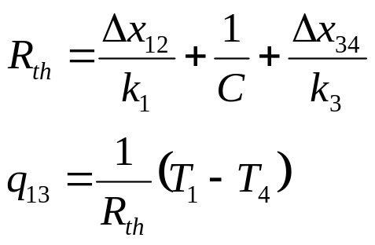
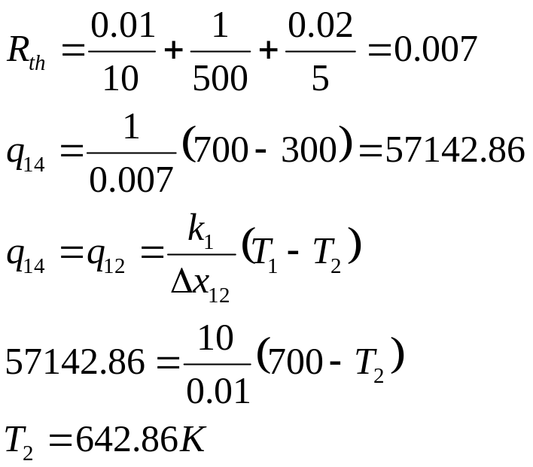
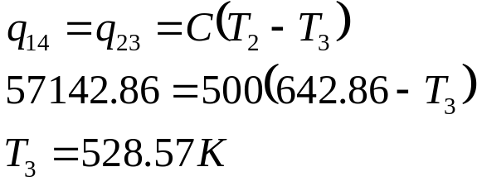
Thermal Contact (cont)
Electrical Analogy
Thus
k₁=10W/mK
k₃=5W/mK
q₁₂ =q₂₃ =q₃₄ =q₁₄
C=500W/m₂K
T₁ =700K
T₂
T₃
T₄ =300K
q₁₂
q₃₄
q₂₃
Δx₁₂ =10mm
Δx₃₄ =20mm

Slide 29
Model Details – Thermal Contact
Open SC03 with hand_calc_base.pm
Locate the geometry for the thermal contact example
Apply Prescribed temperatures using Thermal/Prescribed Temps
Apply Thermal Contact at the interface
Apply a Fixed Joint (Structural/Joints) at the interface
Run the model (Analysis/Run)
Use Results/Get Values to determine the temperatures T₂ and T₃ either side of the interface
T₂
T₃
THERMAL CONTACT
---------------
| PERFECT CONDUCTION TOGGLE | OFF
| CONDUCTANCE | 0.5
PRESCRIBED TEMPERATURES
-----------------------
| INDEX | 3 | INDEX | 4
| TEMPERATURE | t30 | TEMPERATURE | t26
Extension Activity
  Modify values of conductance from 0.1 to 10

Slide 30
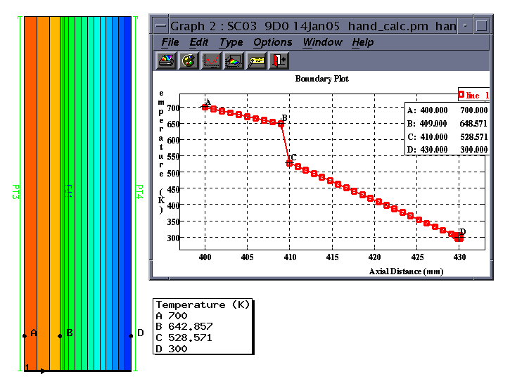
Thermal Contact (cont)
SC03 modelling of the simple case
  hand_calc.pm

Slide 31
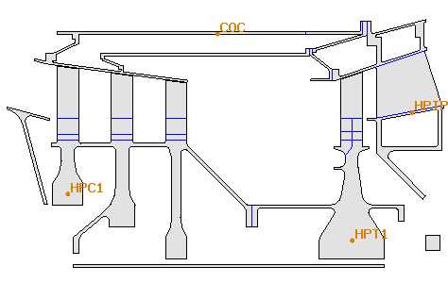
Model Details – Transient Analyses
Open SC03 with transient_scaling.pm
Run the model (Analysis/Run)
Plot graphs (Graphs/Plot graphical item) for:
  grhptcob
  grhpc1cob
  grcoc
  grhpip
Toggle ON the ‘steady-state’ option from Model/Global Control/Thermal Control
Run the model (Analysis/Run)
Re-plot graphs defined above
Copy and paste graphs to compare
Extension Activity
  modify boundary conditions to speed up the response at the COC

Slide 32
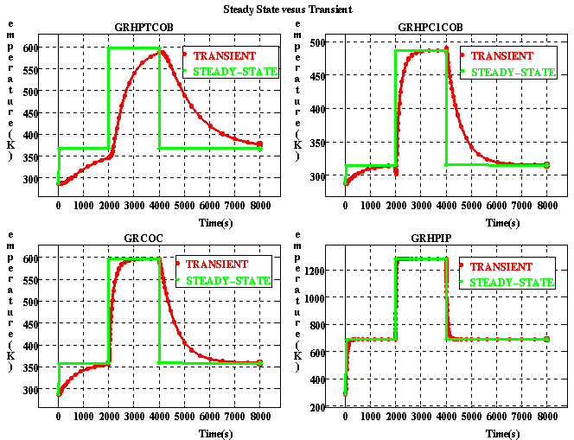
Model Details – Transient Analyses

